Slide 1

EXPLORATORY DATA ANALYSIS ON AMCAT DATA

Slide 2
About me
Background ?
I am Nihal Sayed from Karnataka Pursuing final semester of my MCA at Birla Institute of Technology
Why you want to learn Data Science
Python has always been a great tool for me to explore tech and also create tech , while I do keep researching about various applications or things to do with python , I found data Science very interesting and loved spending time in finding valuable insights from the data and hence choose this to be my career path as it has wide scope as well as good professional development.
Any work experience
I have total 4 months of experience . I have worked as Python Development Intern for 3 Months at Centre of Excellence in Visual Intelligence (CEVI) where in I was responsible for developing annotation software used for data labelling and curation for AI/ML . I Have 1 month of Experience as Core Java Intern at Uniconverge Technologies where in I have worked on a console based HRMS and developed Smal Java modules as Learning-aids
Share your linkedin and github profile urls
https://github.com/Nihal-sayed
https://www.linkedin.com/in/nihal-sayed-2a1758199

Slide 3
Agenda
Business Problem and Use case domain understanding
Objective of the Project
Summary of the Data
Exploratory Data Analysis:
Data Cleaning Steps
Data Manipulation Steps
Univariate Analysis Steps
Bivariate Analysis Steps
Key Business Question
Conclusion (Key finding overall)
Q&A Slide
Your Experience/Challenges working on Web Scraping – Data Analysis Project.

Slide 4
Business Problem and Use case domain understanding
The dataset was released by Aspiring Minds from the Aspiring Mind Employment Outcome 2015 (AMEO). The study is primarily limited only to students with engineering disciplines.
As the dataset is very large and has various information , Analysis is required here to gain valuable insights and information about the data and can be used to determine the outcomes of Engineering students and their jobs and specializations and salary expectations and trends in the technologies

Slide 5
Objective of the Project
To gain valuable insights and information about the data and can be used to determine the outcomes of Engineering students and their jobs and specializations and salary expectations and trends in the technologies

Slide 6
Summary of the Data
The dataset contains the employment outcomes of engineering graduates as dependent variables (Salary, Job Titles, and Job Locations) along with the standardized scores from three different areas – cognitive skills, technical skills and personality skills. The dataset also contains demographic features. The dataset contains around 40 independent variables and 4000 data points. The independent variables are both continuous and categorical in nature. The dataset contains a unique identifier for each candidate

Slide 7
Exploratory Data Analysis:
Data Cleaning Steps
Removal of Unwanted Observations , Fixing Structure errors , Managing Unwanted outliers , Handling Missing Data .
Data Manipulation Steps
Perform data preprocessing , Arrange the data , Transform the data , Perform Data Analysis . CRUD operations

Slide 8
Univariate Analysis
Univariate Analysis is a type of data visualization where we visualize only a single variable at a time. Univariate Analysis helps us to analyze the distribution of the variable present in the data
Uses Seaborn library
Histograms , Boxplots , Countplots etc
Bivariate Analysis
Bivariate analysis is the simultaneous analysis of two variables. It explores the concept of the relationship between two variable whether there exists an association and the strength of this association or whether there are differences between two variables and the significance of these differences
The main three types are:
Categorical v/s Numerical
Numerical V/s Numerical
Categorical V/s Categorical data

Slide 9
Key Business Question
Times of India article dated Jan 18, 2019 states that “After doing your Computer Science Engineering if you take up jobs as a Programming Analyst, Software Engineer, Hardware Engineer and Associate Engineer you can earn up to 2.5-3 lakhs as a fresh graduate.”
Is there a relationship between gender and specialization? (i.e. Does the preference of Specialisation depend on the Gender?)

Slide 10
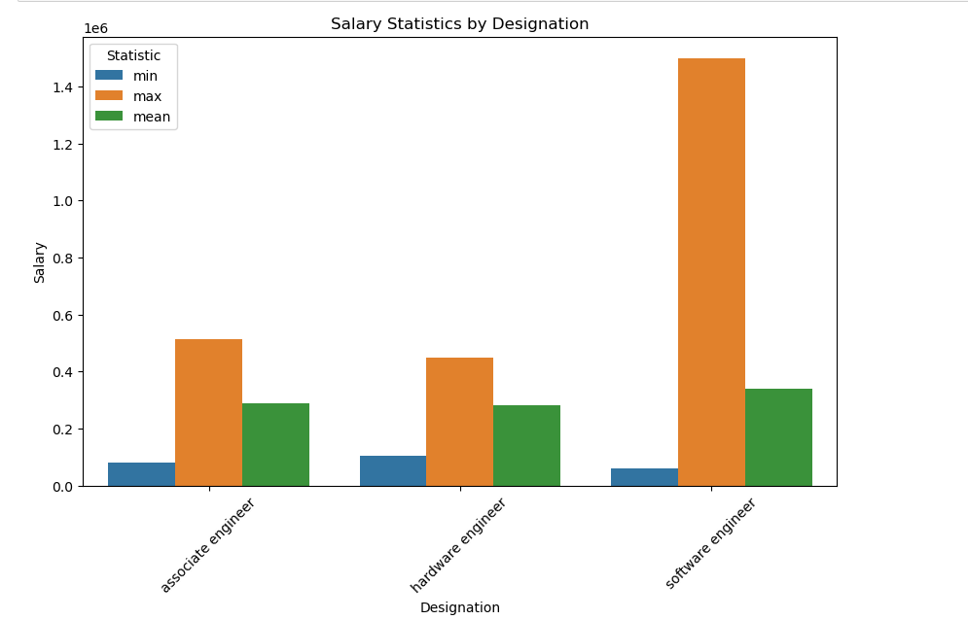
Conclusion
The claim from Times of India turns out to be true as the Average salary of Programming Analyst, Software Engineer, Hardware Engineer and Associate Engineer is 3.9Lakhs and can be represented using plot below

Slide 11

THANK YOU

